Slide 1
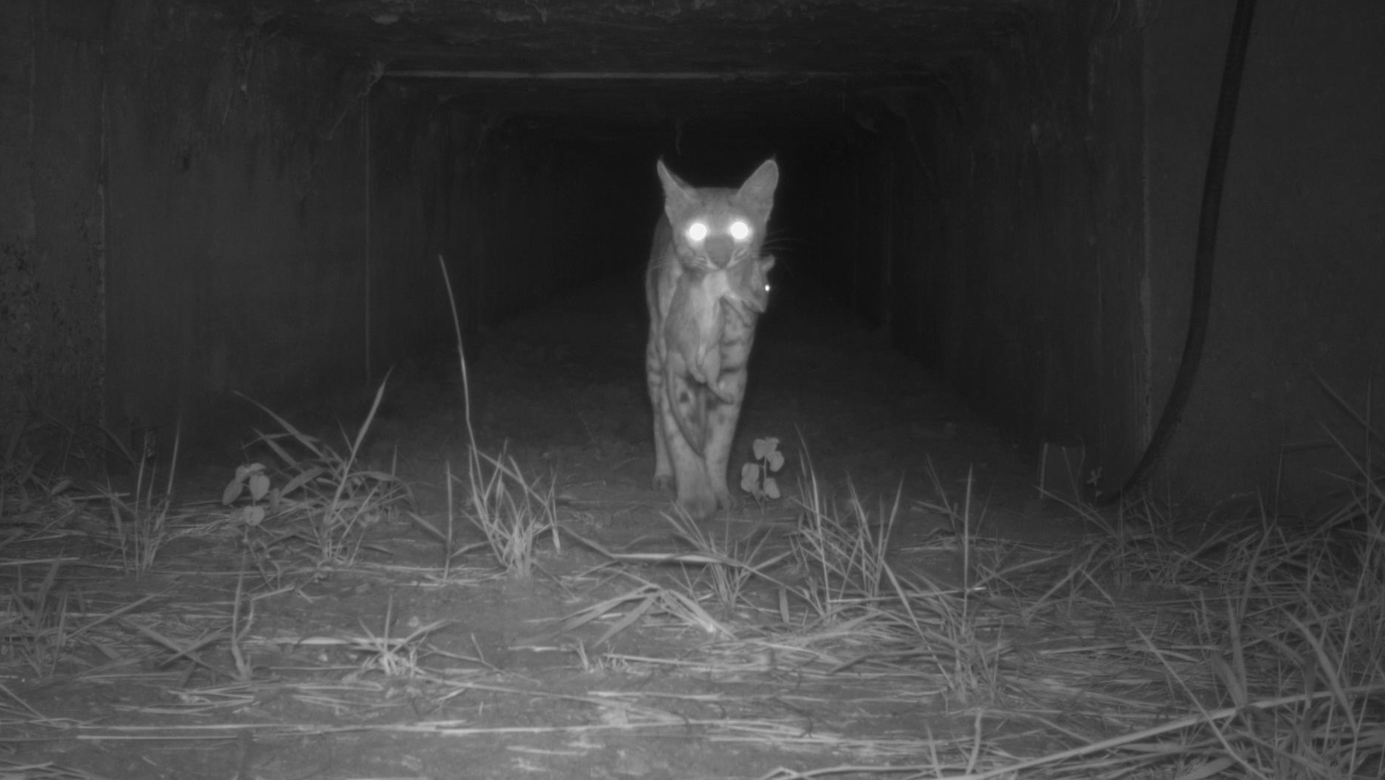
Rodent road ecology in south Texas and the potential bottom-up effects on rodent predators
Proposal Presentation

Slide 2
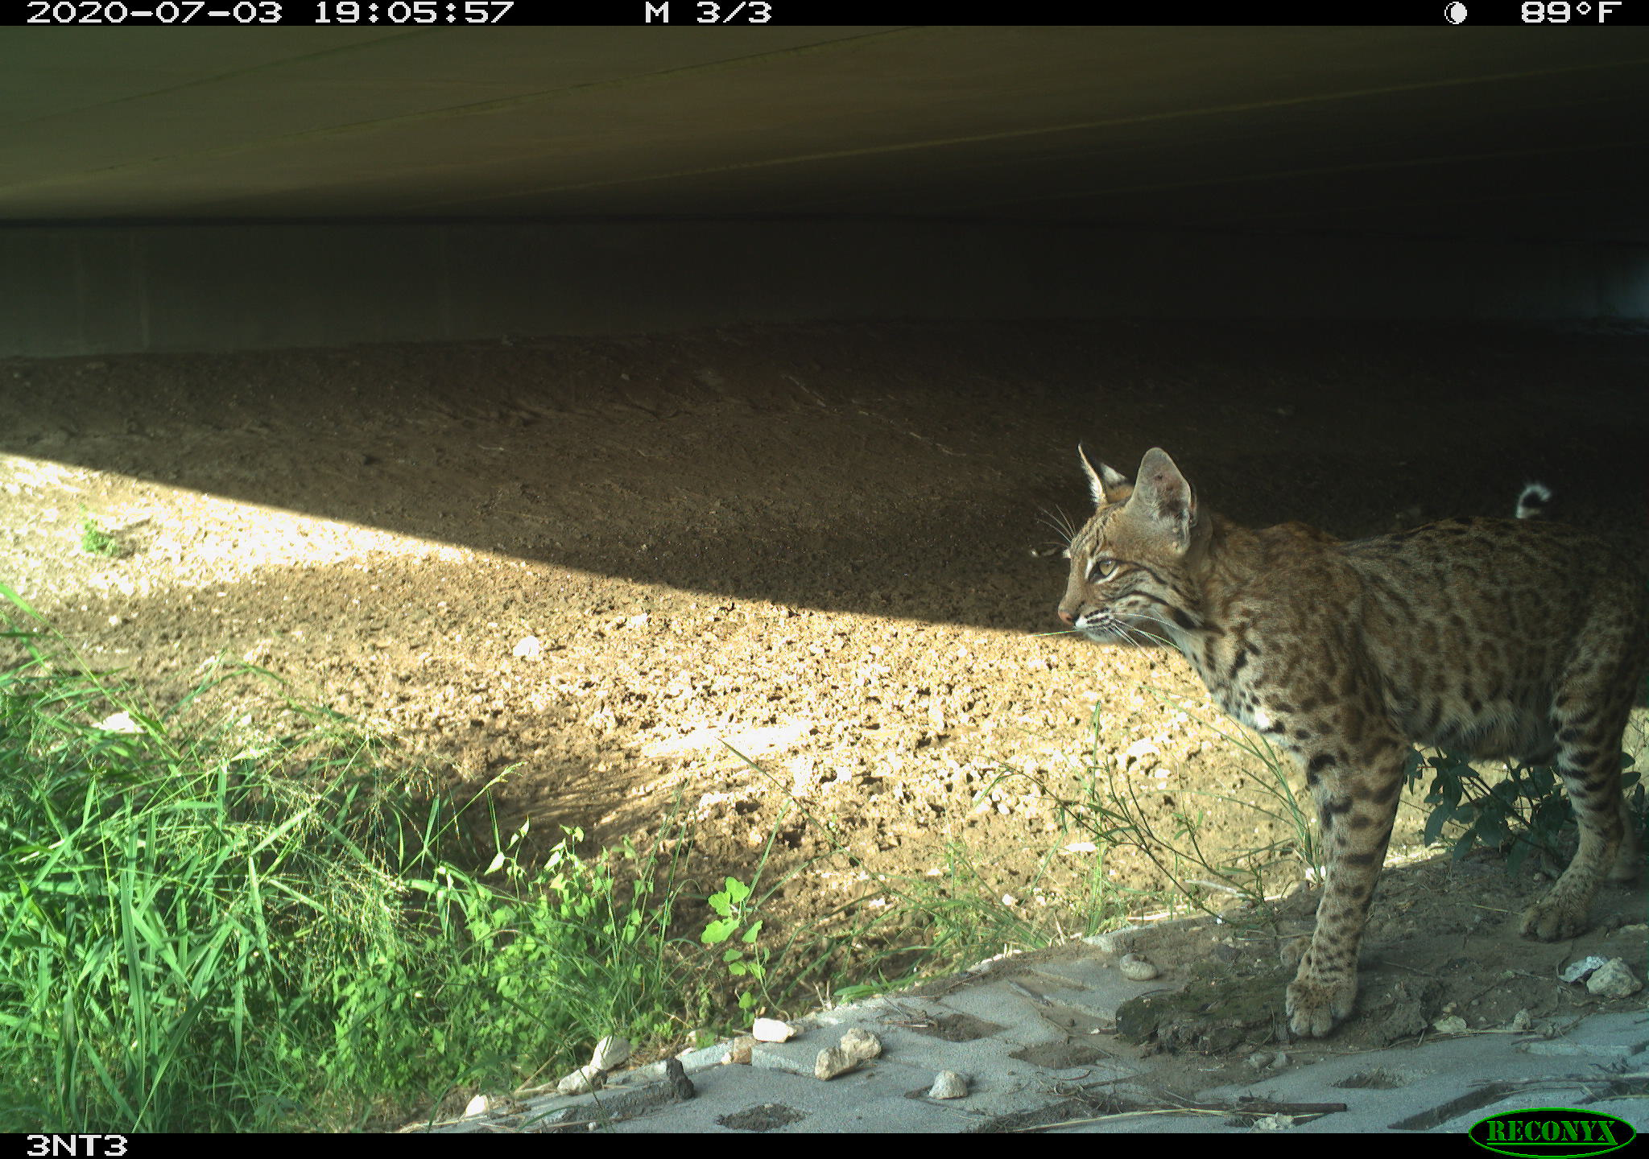
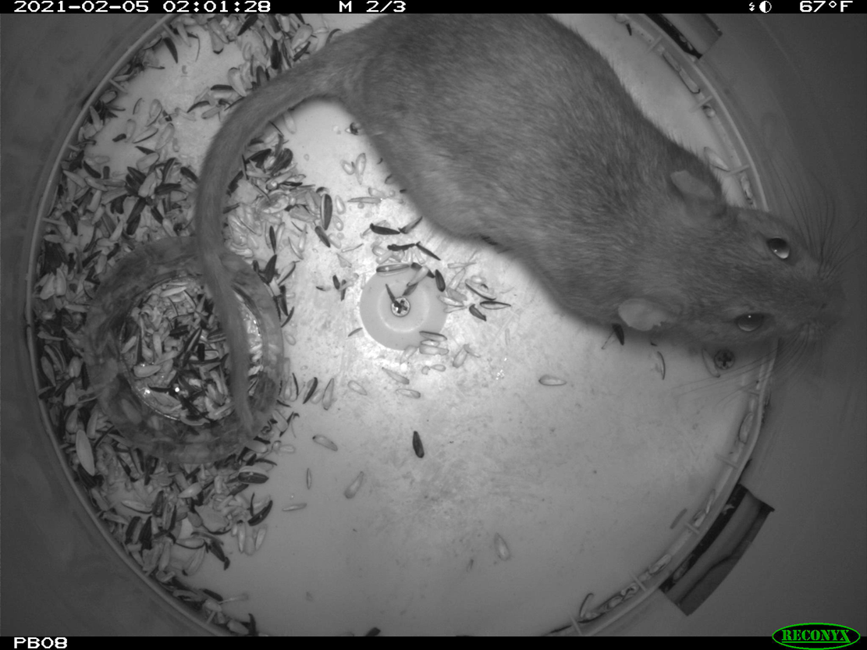
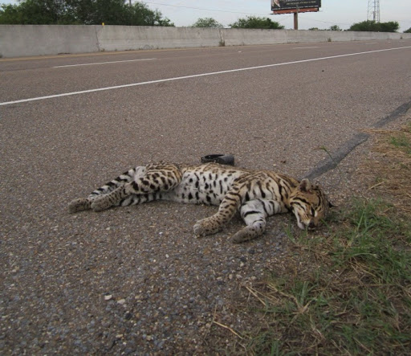
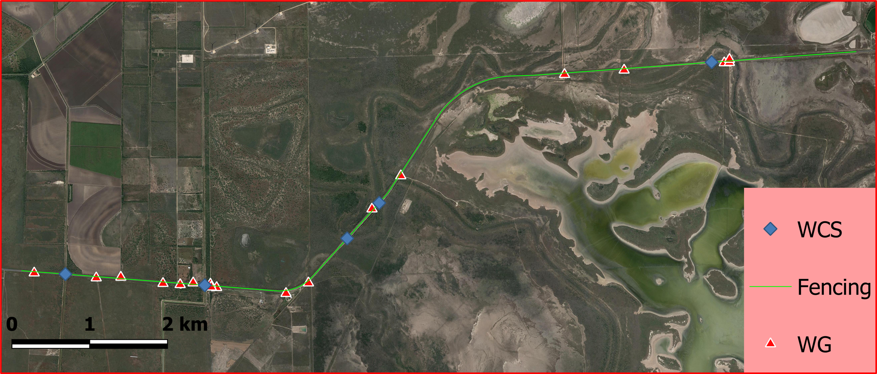
Background Info and Data Collection
Study Area on SH 100
Overall purpose of project is wildlife road mortality mitigation
Camera data for rodents
Camera data for predators

Slide 3
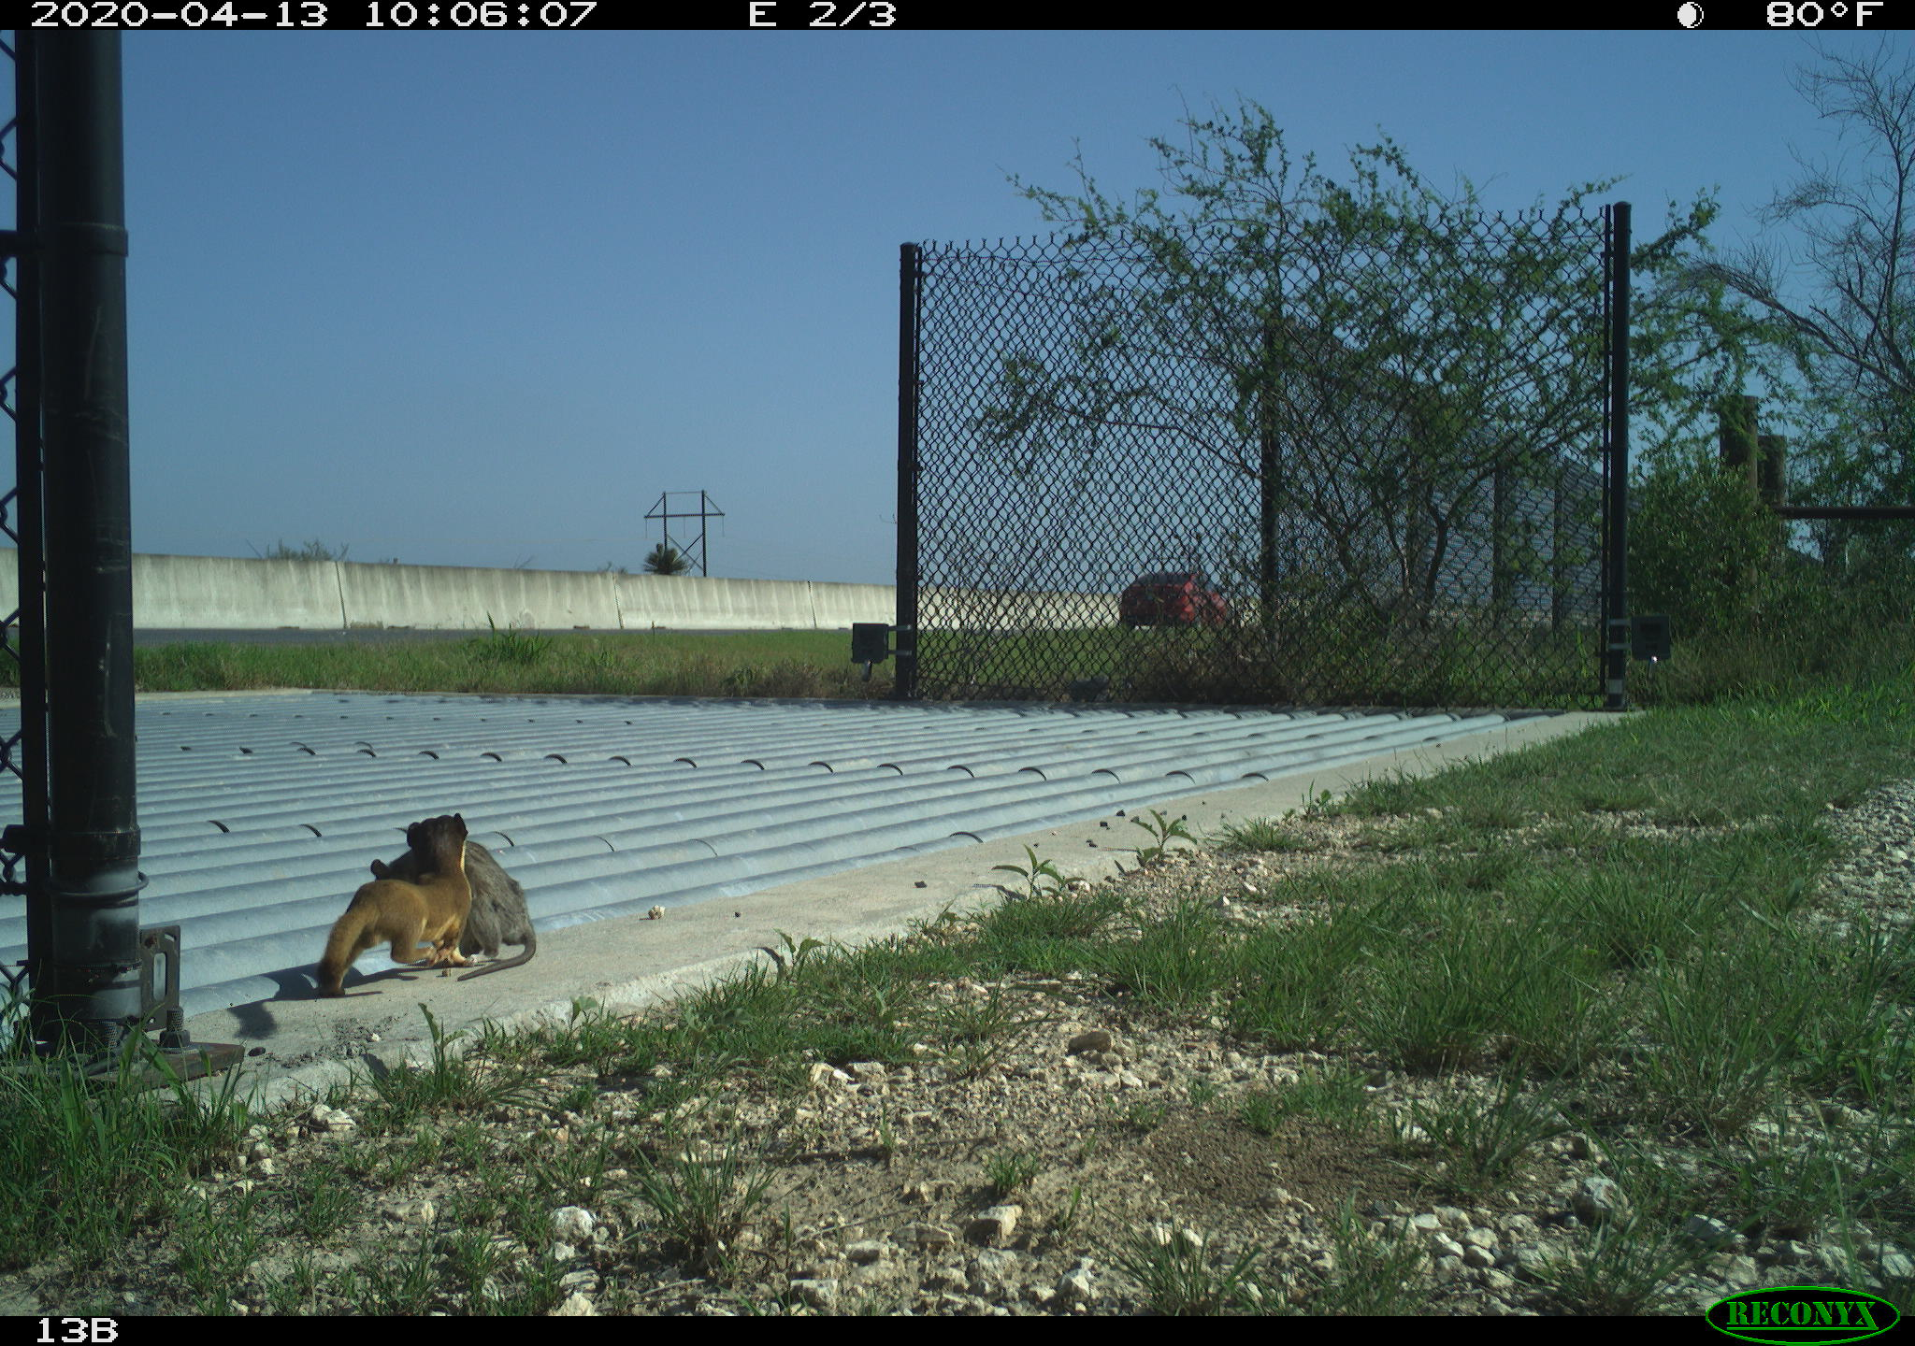
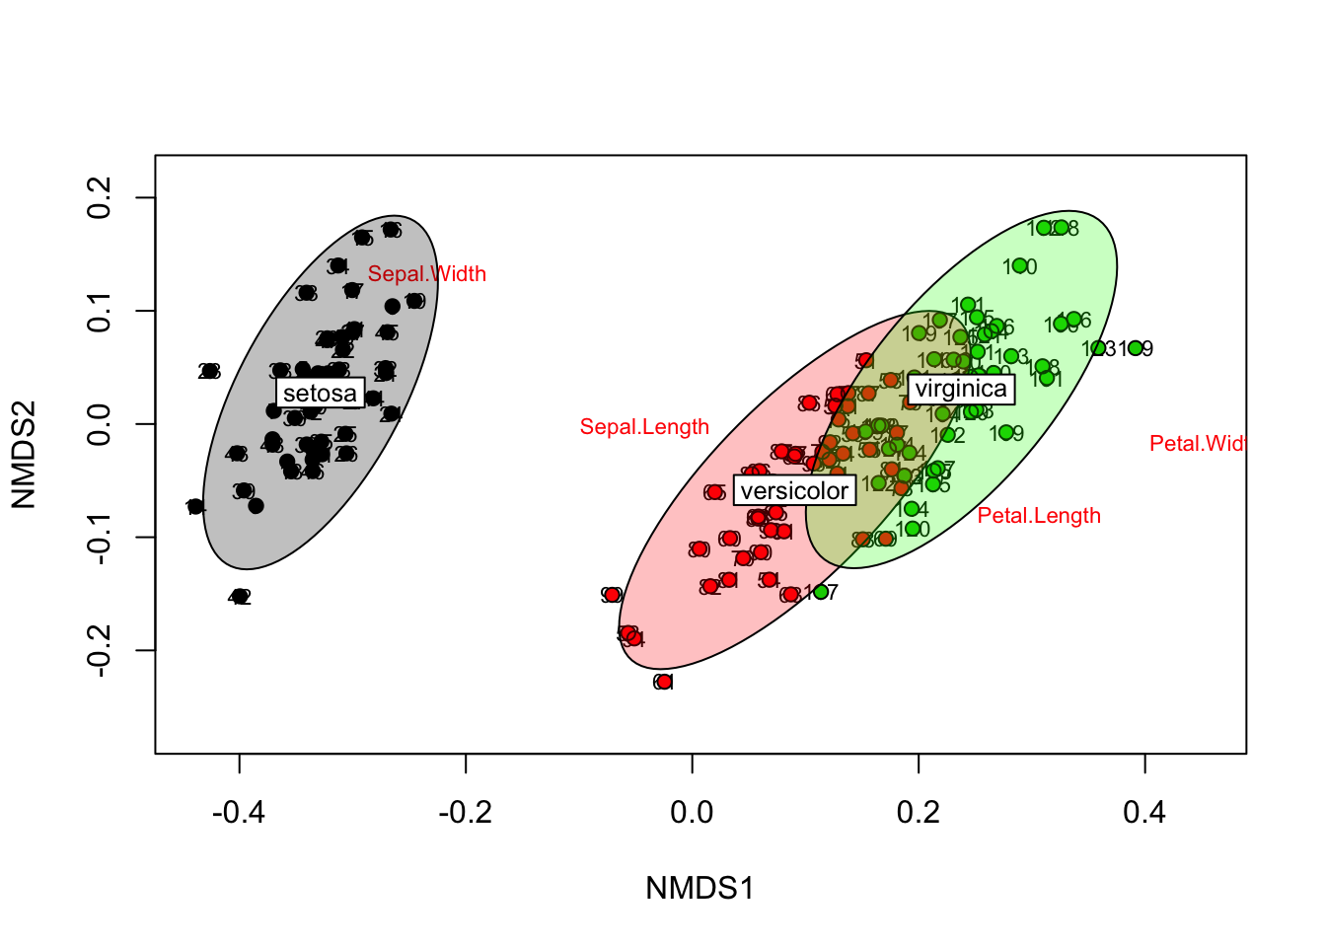
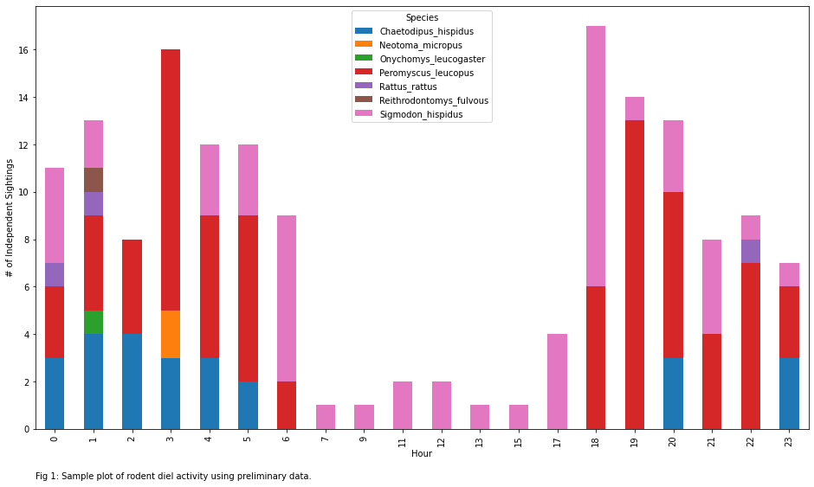
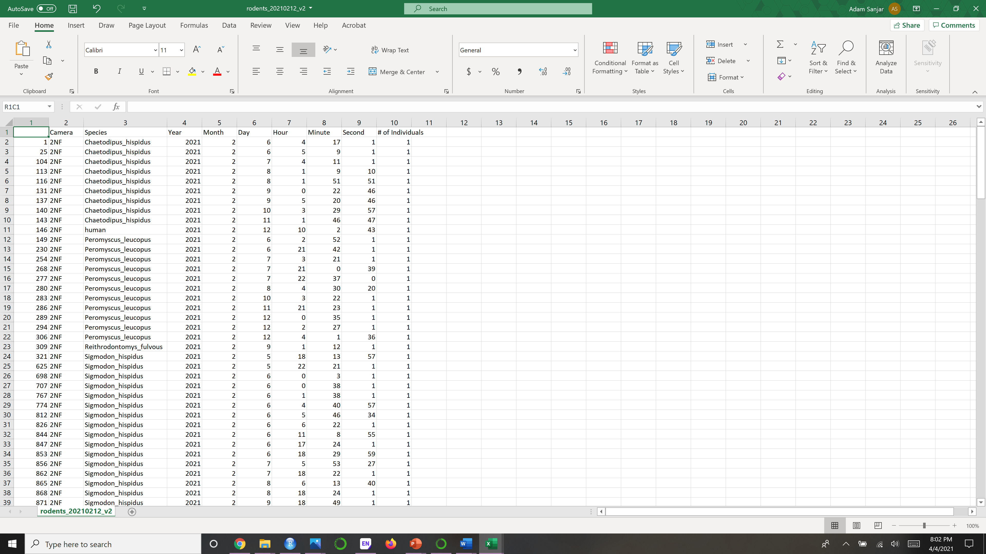
Data Analysis
Data converted to .csv using R and 30-minute interval independent interactions are generated
Diel patterns are generated
PERMANOVA or ANOSIM are run
Rodent activity correlation to predator abundance analyzed using a regression on a scatterplot

Slide 4
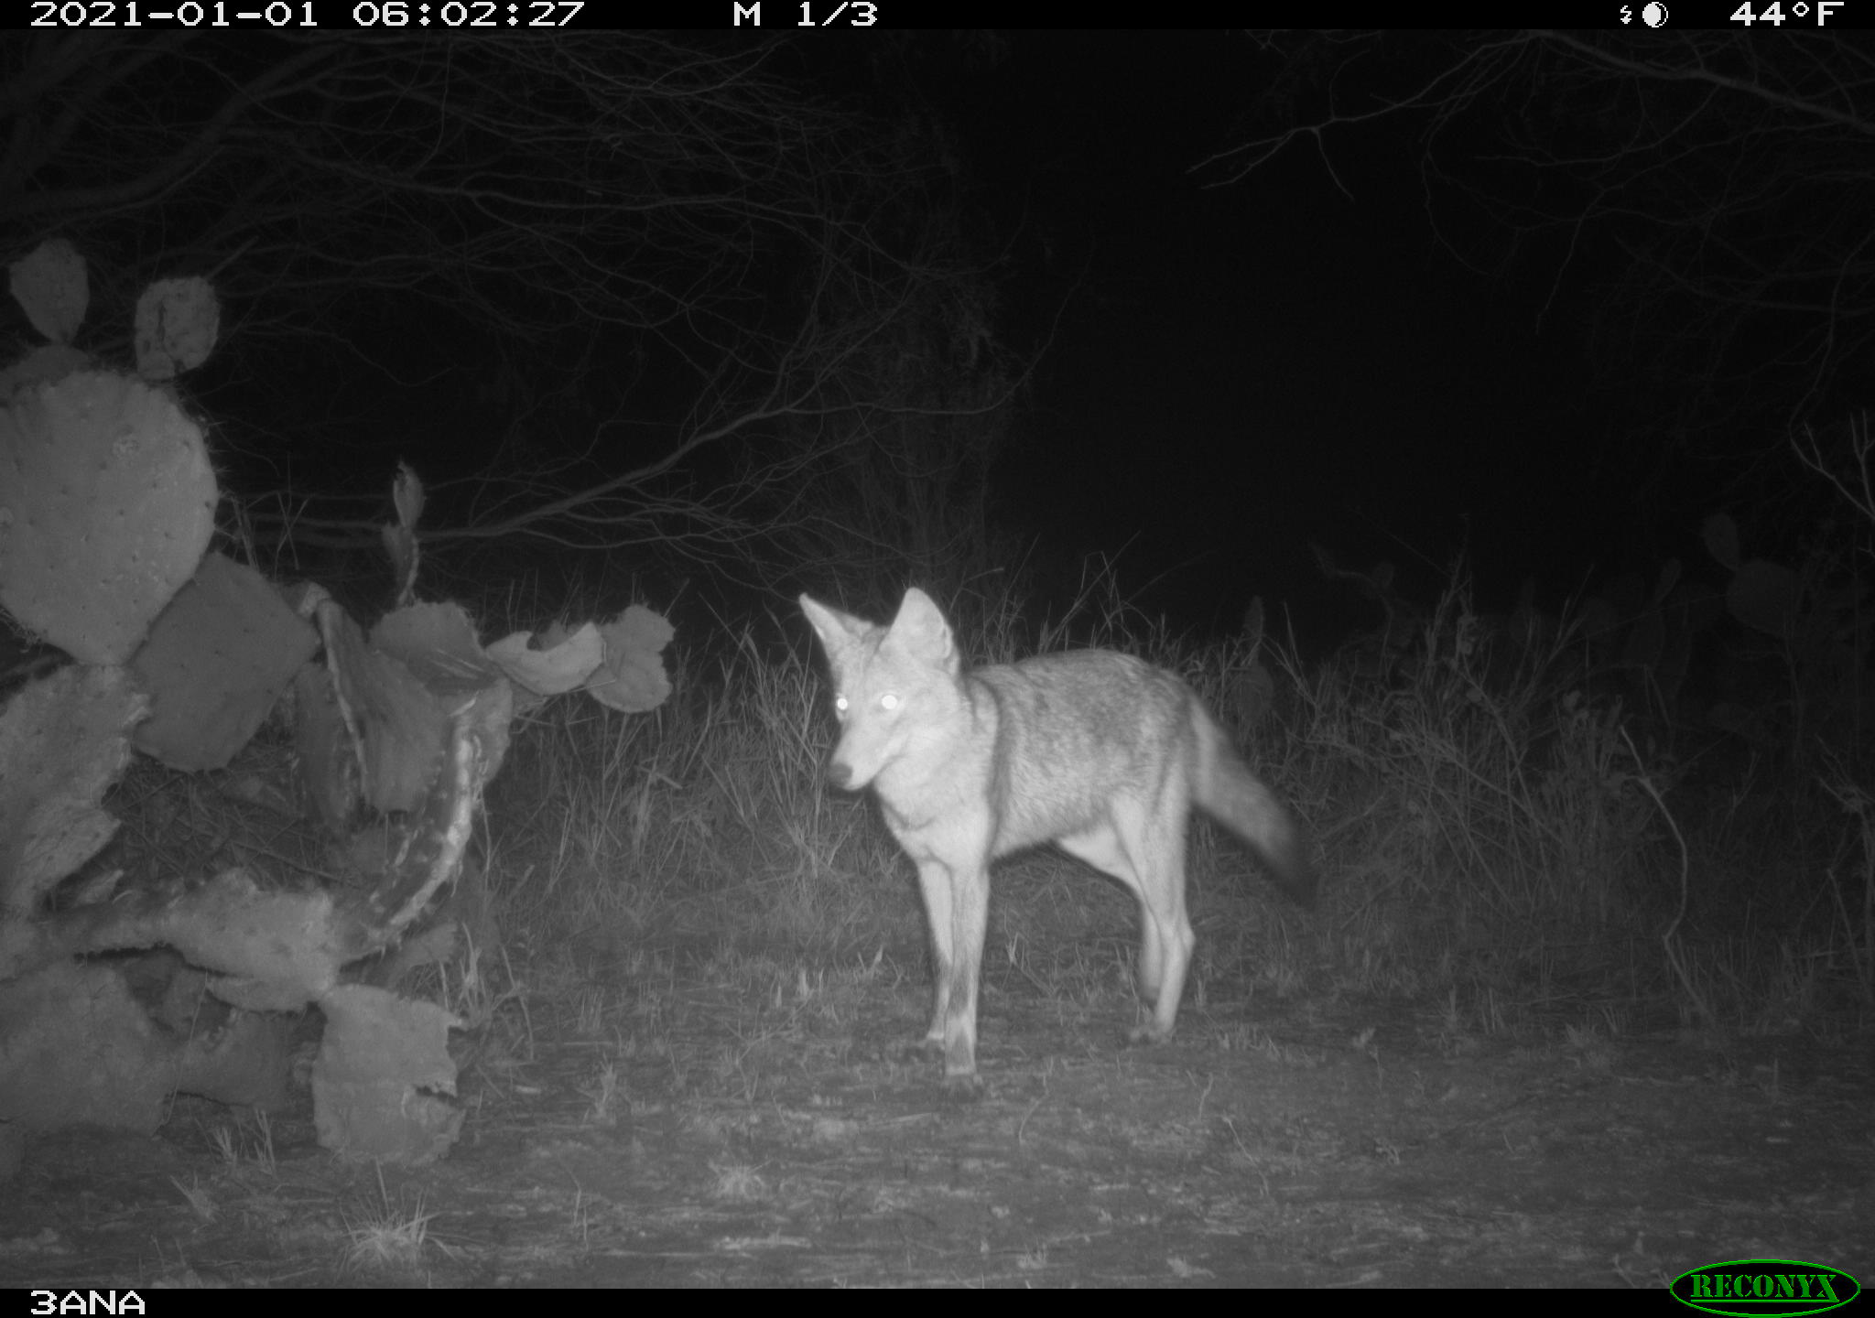
Questions?

